Slide 1
FAKE NEWS IDENTIFICATION USING ENSEMBLE LEARNING

Slide 2

Problem Statement
Detection of fake news in social media.

Slide 3
Impact Of Fake News
Reputation
Political Events
Mob lynching, Cow slaughtering etc.

Slide 4
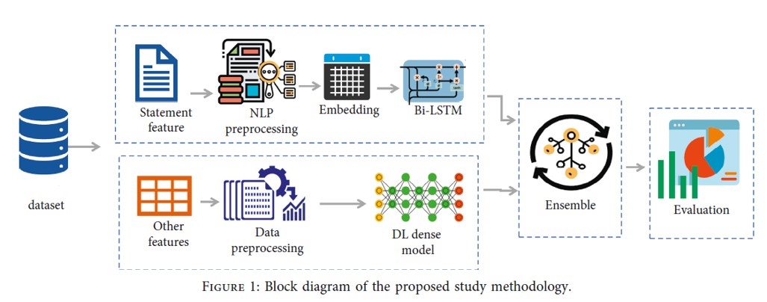

Slide 5
Dataset
We have used the following benchmark dataset :
1) LIAR
2) POLITIFACT
3) ISOT

Slide 6
Data Cleaning
Removing Unnecessary Data.
Relabelling Of labels.
Handling NaN.

Slide 7
Text Preprocessing
Combining all the dataset that we have taken.
Tokenization
Removal of stopwords, urls etc.
Lemmatization.

Slide 8

Features
1) Name Entity Recognition

Slide 9

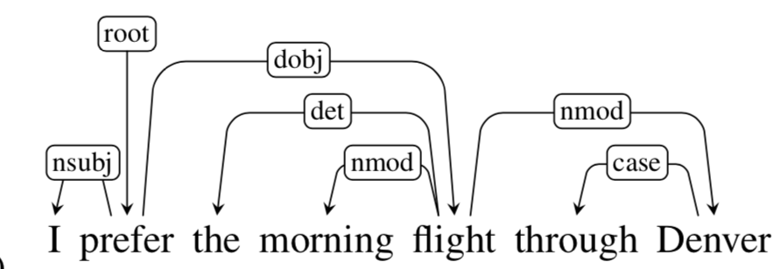
2) Part of Speech Tagging
3) Dependencies

Slide 10
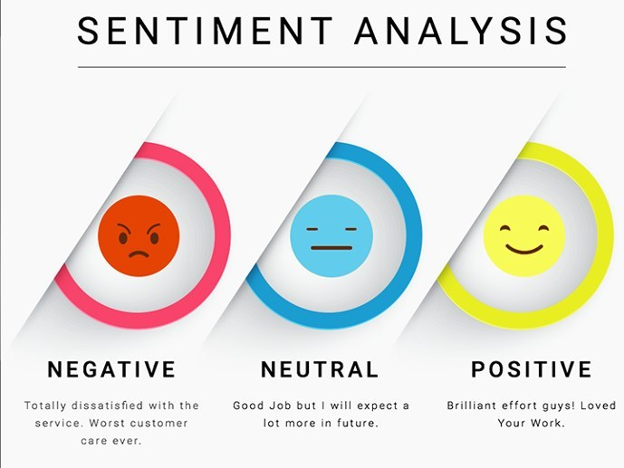
4) Sentiment

Slide 11
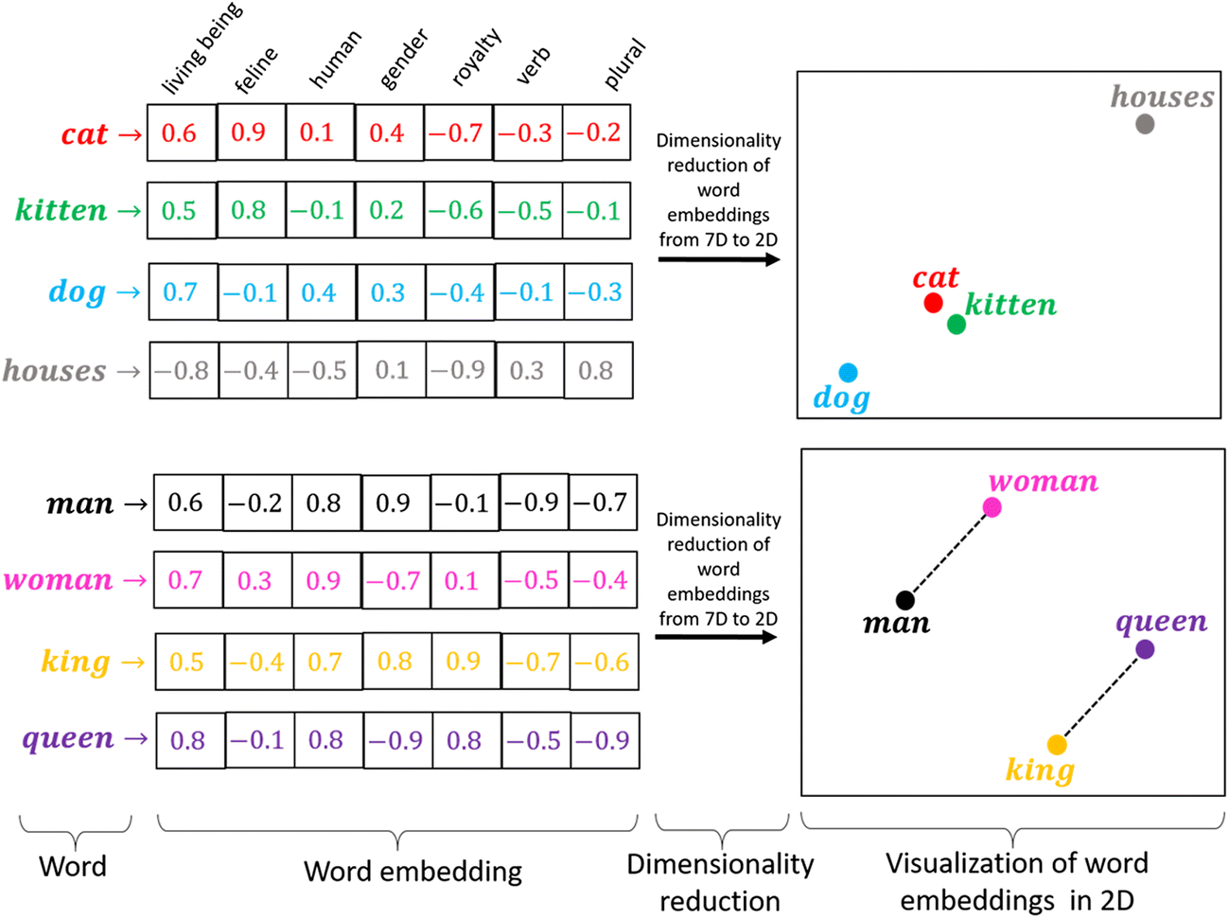
5) Word Embeddings

Slide 12
Model Selection

Slide 13
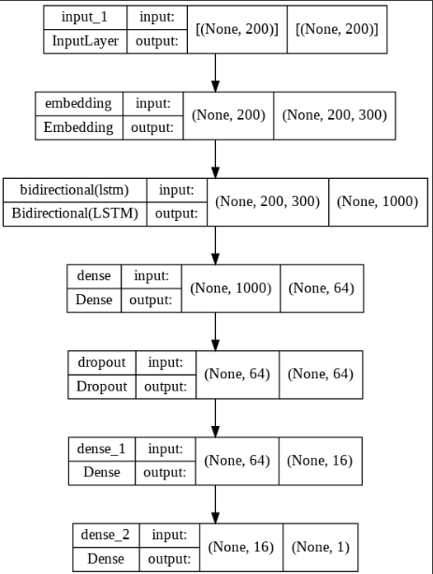
Model 1

Slide 14
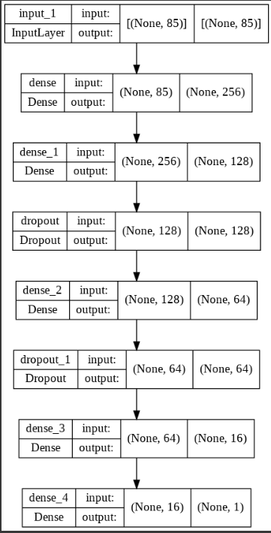
Model 2

Slide 15
Model 3
Model 3 is the ensemble of the following:
Model 1- (with sentiments, Count of postags, Dependencies and Named Entities)
Model2 - (Bi-LSTM with Embeddings)
And we have Find the weighted average.

Slide 16
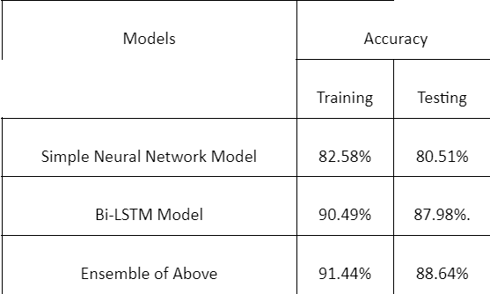
Result

Slide 17
Conclusion
We have used word embeddings as input for training and testing purposes consisting of LSTM and neural networks.
We have used the NER, POS Tagging, Dependencies, Sentiment.
Altogether our proposed model gives decent accuracy of 88.64% on testing.

Slide 18
Future Scope
Hyper parameter tuning will be done on model in future.
Certain modifications in feature extraction and model selection according the dataset present is always possible.

Slide 19



